Slide 1
Machine Learning CS F464
Dr. Pranav M. Pawar

Slide 2
Contents
Ensemble Learning
Bagging
Boosting
Random Forest

Slide 3
Basic Idea
Concordet’s jury theorem (1785): imagine that a group of people has to select between two choices (from which only one is correct). They vote independently, and the probability that they vote correctly is p. The votes are combined by the majority rule. Let M denote the probability that the majority vote is correct.
Concordet’s theorem says that if p>0.5 then M→1 if the number of votes goes to infinity
This means that the crowd is more clever than the individuals under relatively weak assumptions
Each individual must be correct with p>0.5 (better than random guessing)
Their should make independent decisions
Now, how can we apply this idea in machine learning?
Ensemble learning is the process by which multiple models, such as classifiers or experts, are strategically generated and combined to solve a particular computational intelligence problem

Slide 4
Strong vs. weak learners
Strong learner: we seek to produce one classifier for which the classification error can be made arbitrarily small
Weak learner: a classifier which is just better than random guessing
Ensemble learning: instead of creating one strong classifier, we create a huge set of weak classifiers, then we combine their outputs into one final decision
According to Concordet’s theorem, under proper conditions we can expect that the ensemble model can attain an error rate that is arbitrarily close to zero
While creating a lot of weak classifiers is hopefully a much easier task than to create one strong classifier

Slide 5
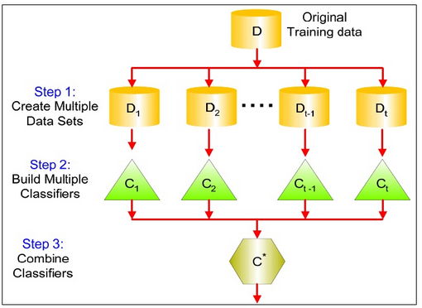
Ensemble Learning

Slide 6
Conditions
Training the same classifier on the same training data several times would give the same result for most machine learning algorithms
Exception: methods where the training involves some randomness
Combining these classifiers would make no sense
Classifier combination gives the best result if
The classifier outputs for the same input are diverse
The classifiers operate independently (or at least partially independently)
The classifiers have some unique or “local” knowledge
E.g. they are trained on different (or at least partially different) training data sets
Must have some formalism to combine (aggregate) the opinions of the various classifiers

Slide 7
How to produce diverse classifiers?
Can combine different learning algorithms (“hybridization”)
E.g. can train a GMM, an SVM, a k-NN,… over the same data, and then combine their output
Can combine the same learning algorithm trained several times over the same data
This works only if there is some random factor in the training method
E.g.: neural networks trained with different random initialization
Can combine the same learning algorithm trained over different subsets of the training data
Can also try using different subsets of the features
Or different subsets of the target classes (multi-class task, lot of classes)
For certain algorithms we can use the same algorithm over the same data, but with a different weighting over the data instances

Slide 8
Randomization of decision trees
The decision tree is a very popular choice for combination-based methods
(Small) decision trees are not really efficient classifiers
But their training is very simple and fast, so it is very easy to create an ensemble learner from a huge set of (small) decision trees
The decision tree algorithm is deterministic, how can we modify it to produce different learners at different runs?
Data randomization – use different subsets of training data for each tree
“Random subspace” method – each tree is grown using a random subset of the features
Algorithm randomization – instead of choosing the best attribute for node splitting, we select an attribute randomly from the K best attributes

Slide 9
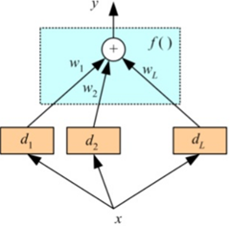
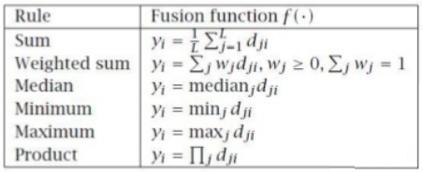
Aggregation methods
There are several methods to combine (aggregate) the outputs of the various classifiers
When the output is a class label:
Majority voting
Weighted majority voting (e.g we can weight each classifier by its reliability (which also has to be estimated somehow, of course…)
When the output is numeric (e.g. a probability estimate for each class c_{i}):
We can combine the d_{j} scores by taking their (weighted) mean, product, minimum, maximum, …
Stacking
Instead of using the above simple aggregation rules, we can train yet another classifier on the output values of the base classifiers

Slide 10
Ensemble-based methods
Classifier combination is a general concept that can be applied for any training task, and by using any set of classifiers that are diverse (according to the previous slides)
But today we concentrate on those algorithms that were specially invented to exploit the ensemble approach
They will create a large set of classifiers, here called the “base learners”
These classifiers can be weak, as we expect that the power of these methods will be in the ensemble approach
Will create a lot from these base classifiers
Will try to force them to be diverse, or in better methods, to complement each other
During their combination will seek maximum classification accuracy
These methods will be:
Bagging, Boosting, AdaBoost, Random Forests

Slide 11
Bagging
Bagging = Bootstrap + aggregating
It uses bootstrap resampling to generate L different training sets from the original training set
On the L training sets it trains L base learners
During testing it aggregates the L learners by taking their average (using uniform weights for each classifiers), or by majority voting
The diversity or complementarity of the base learners is not controlled in any way, it is left to chance and to the instability of the base learning method
The ensemble model is almost always better than the unique base learners if the base learners are unstable (which means that a small change in the training dataset may cause a large change in the result of the training)

Slide 12
Bootstrap resampling
Suppose we have a training set with n samples
Would like to create L different training sets from this
Bootstrap resampling takes random samples from the original set with replacement
Randomness is required to obtain different sets for L rounds of resampling
Allowing replacement is required to be able to create sets of size n from the original data set of size n
As the L training sets are different, the result of the training over these set will also be more or less different, independent of what kind of training algorithm we use
Works better with unstable learners (e.g. neural nets, decision trees)
Not really effective with stable learners (e.g. k-NN, SVM)

Slide 13
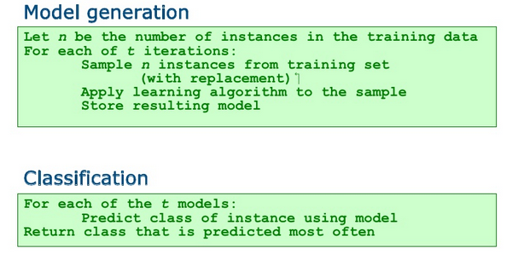
Bagging -Summary

Slide 14
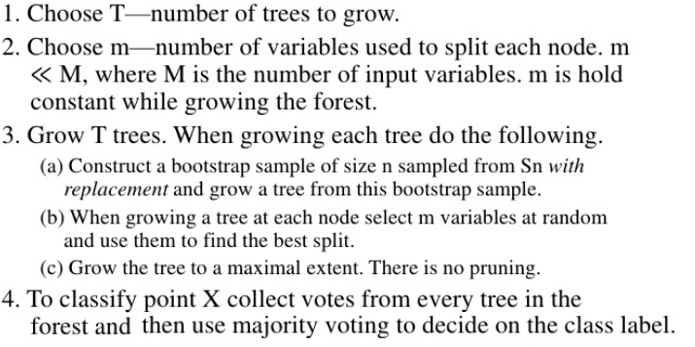
Random Forests
Random forest (or random forests) is an ensemble classifier that consists of many decision trees and outputs the class that is the mode of the class's output by individual trees.
Input: training data set Sn, T, m

Slide 15
Boosting 1
Bagging created a diversity of base learners by creating different variants of the training dataset randomly
However, we do not have direct control over the usefulness of the newly added classifiers
Would expect a better performance if the learners also comple-mented each other
They would have “expertise” on different subsets of the data
So they would work better on different subsets
The basic idea of boosting is to generate a series of base learners which complement each other
For this, we will force each learner to focus on the mistakes of the previous learner

Slide 16
Boosting 2
Represent the importance of each sample by assigning weights to the samples
Correct classification → smaller weights
Misclassified samples → larger weights
The weights can influence the algorithm in two ways
Boosting by sampling: the weights influence the resampling process
This is a more general solution
Boosting by weighting: the weights influence the learner
Works only with certain learners
Boosting also makes the aggregation process more clever: We will aggregate the base learners using weighted voting
Better weak classifier gets a larger weight
We iteratively add new base learners, and iteratively increase the accuracy of the combined model

Slide 17
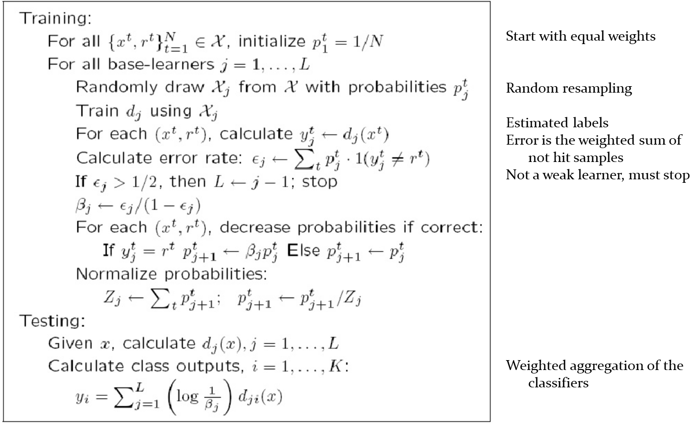
AdaBoost 1 (Adaptive Boosting)

Slide 18
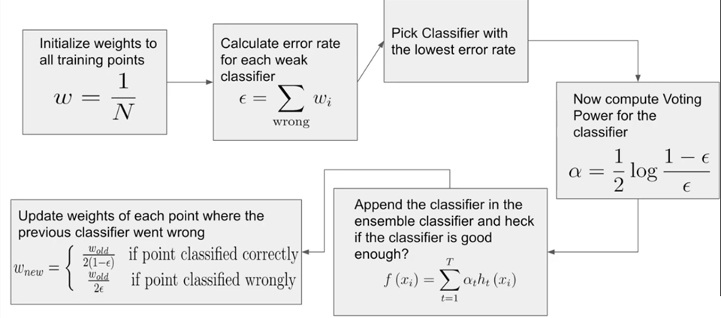
Ada Boost 2

Slide 19
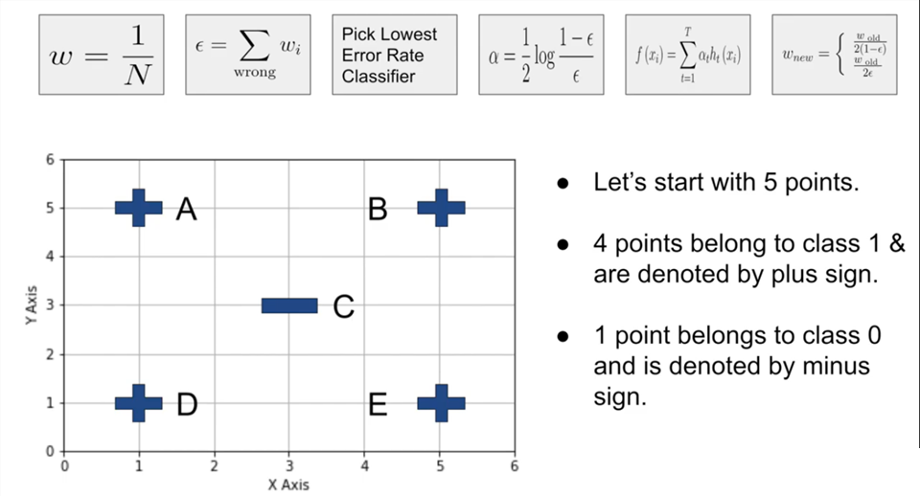
Ada Boost Example 1

Slide 20
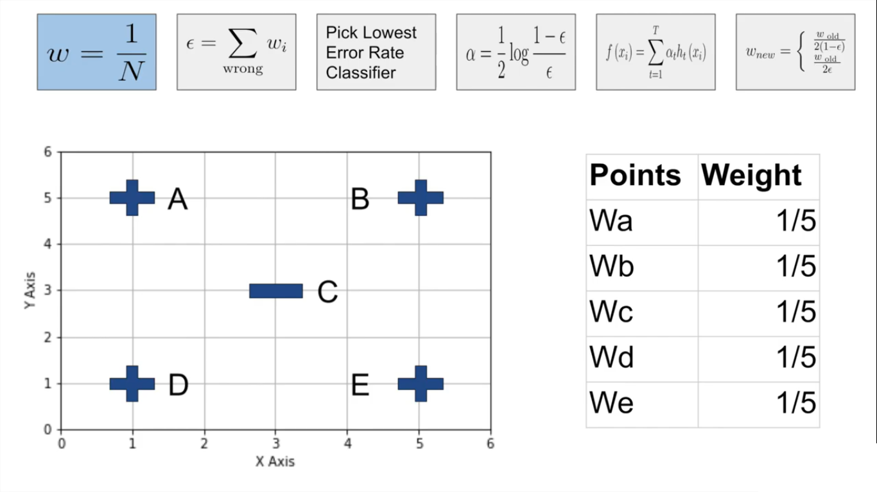
Ada Boost Example

Slide 21
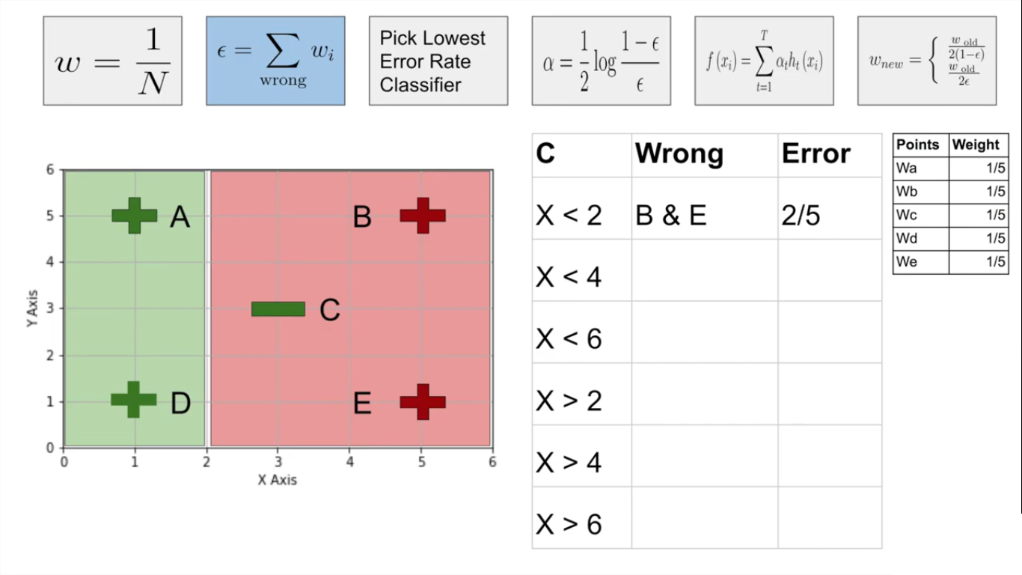
Ada Boost Example

Slide 22
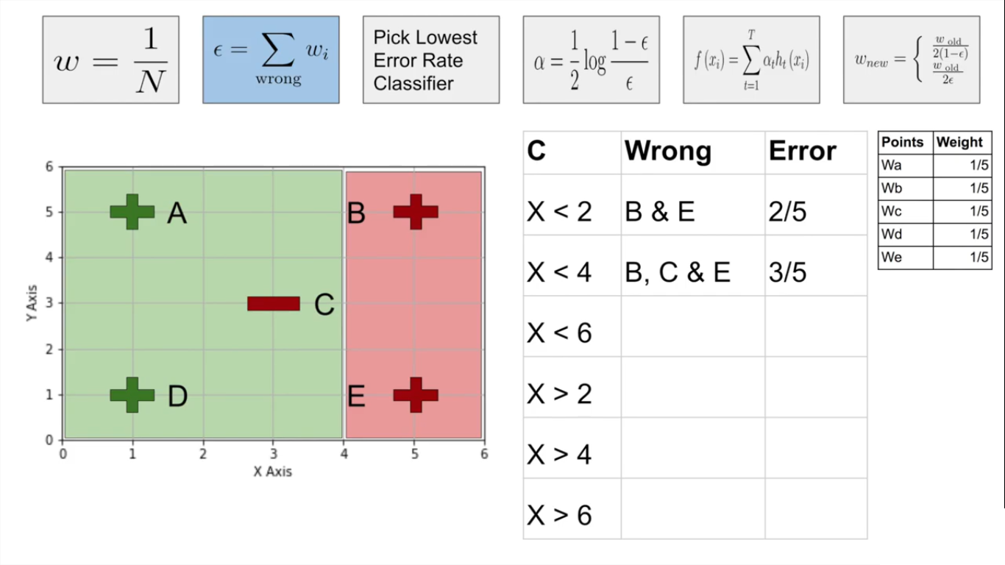
Ada Boost Example

Slide 23
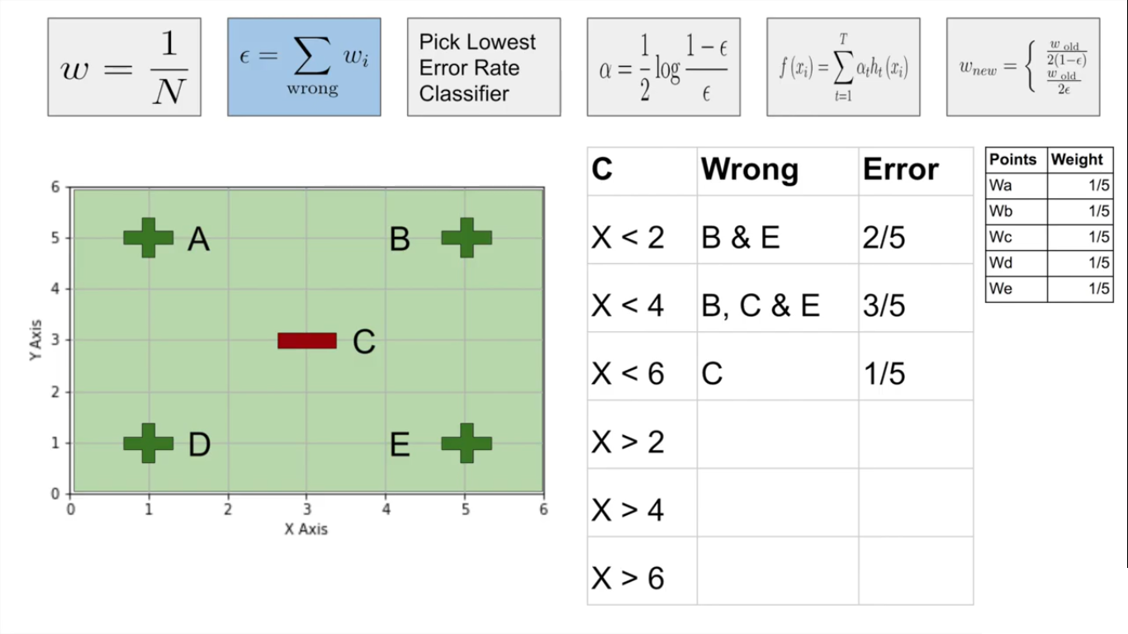
Ada Boost Example

Slide 24
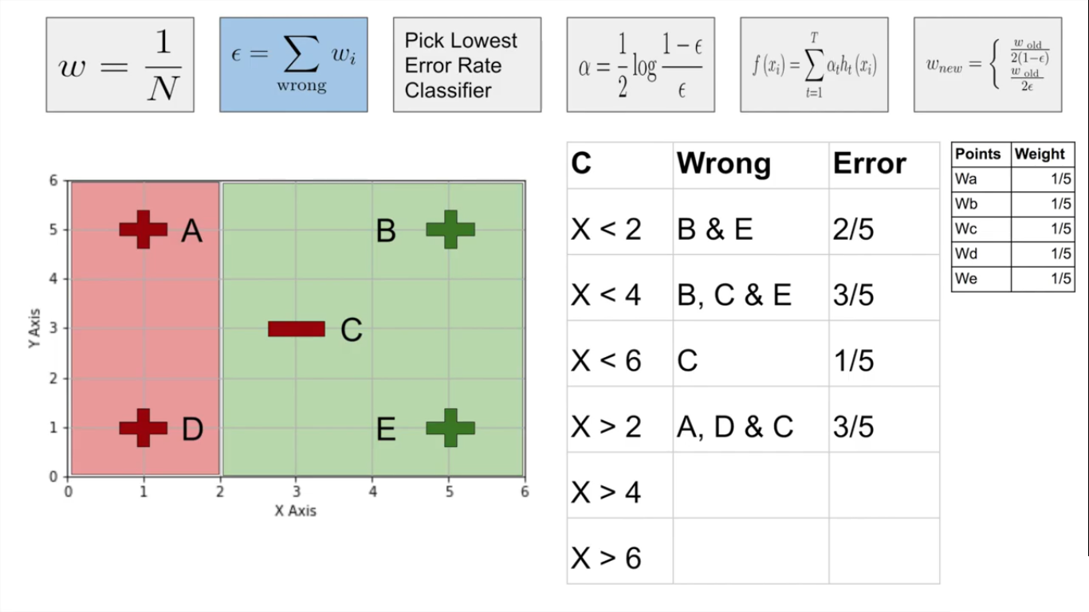
Ada Boost Example

Slide 25
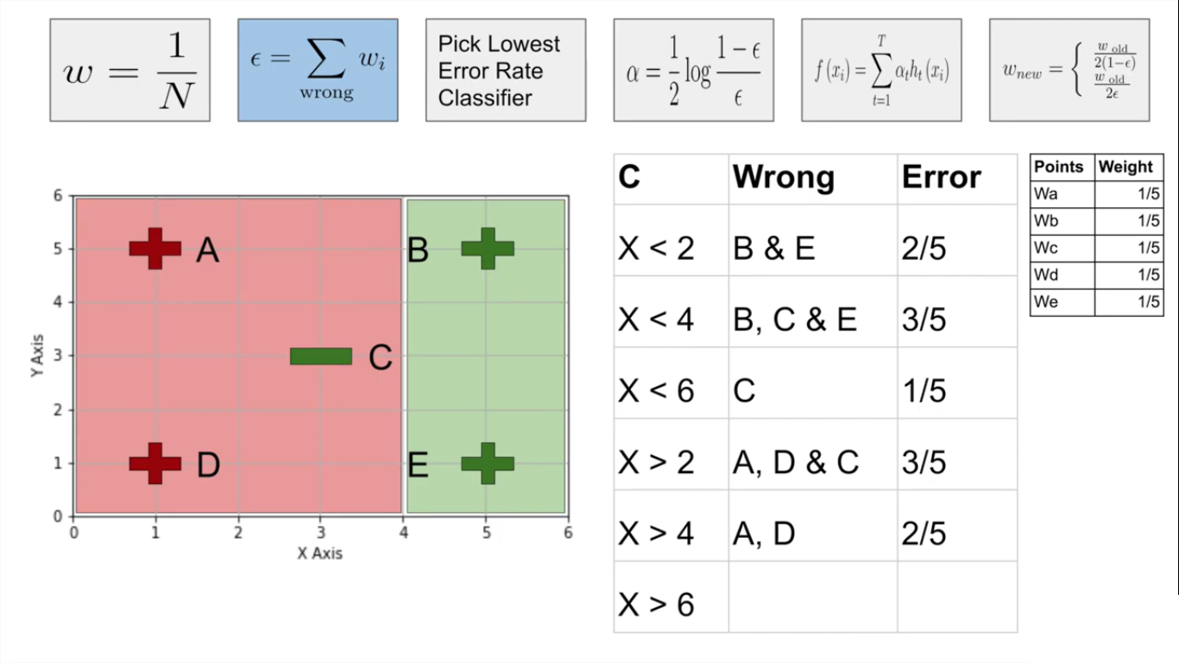
Ada Boost Example

Slide 26
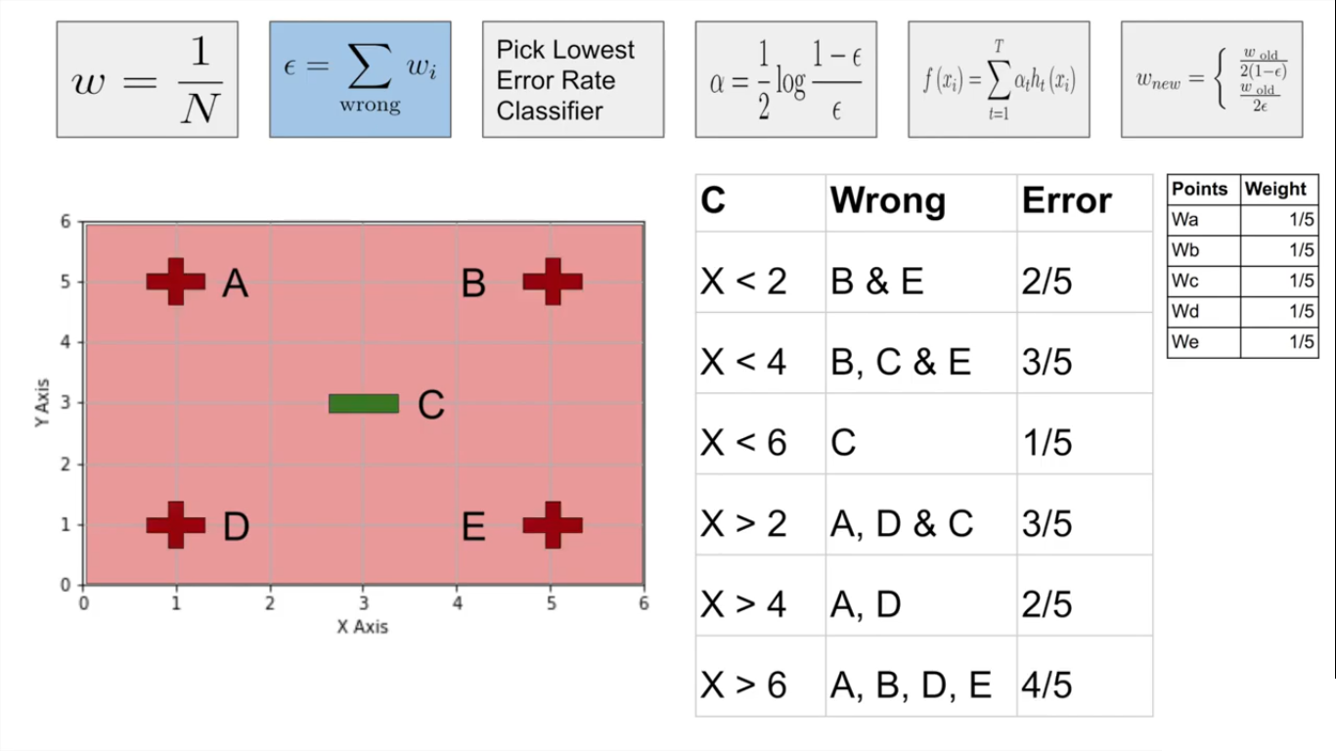
Ada Boost Example

Slide 27
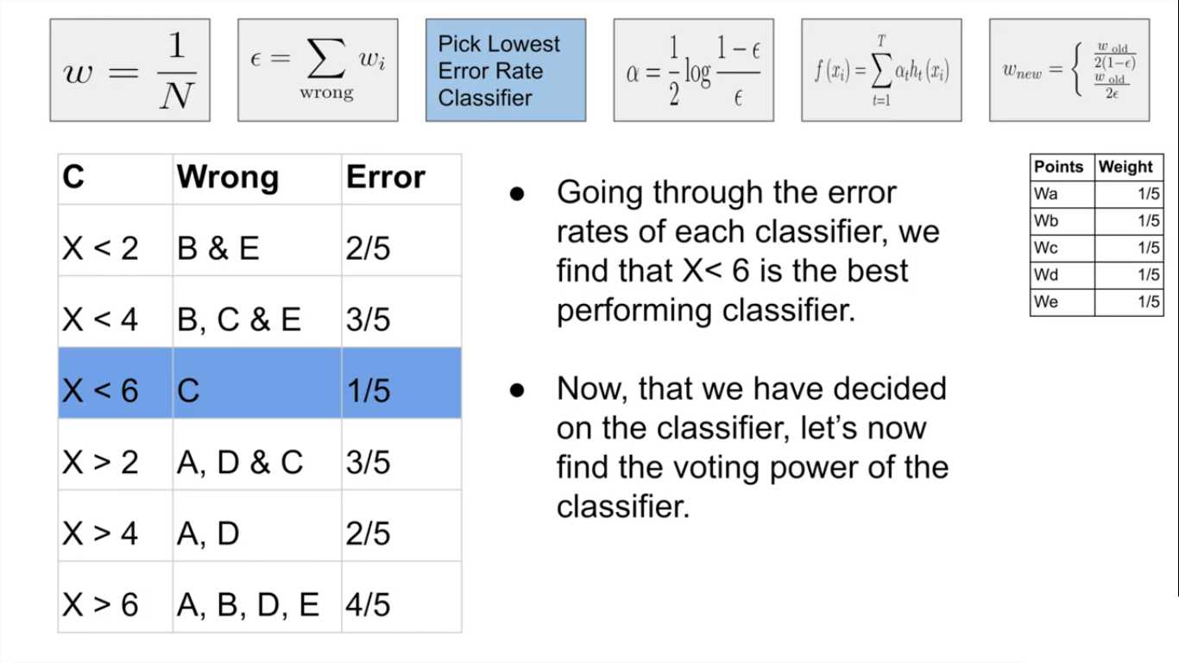
Ada Boost Example

Slide 28
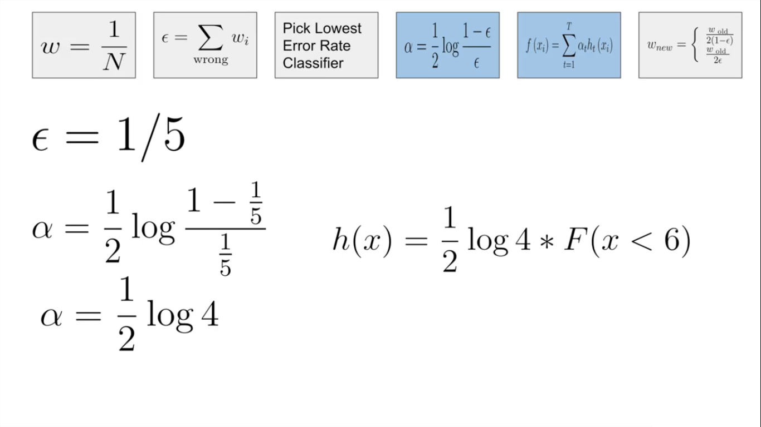
Ada Boost Example

Slide 29
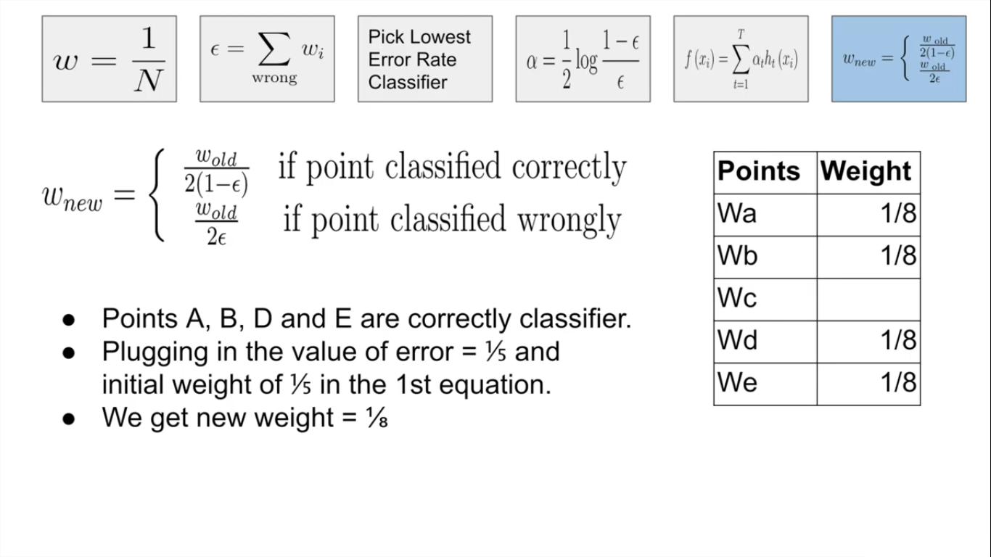
Ada Boost Example

Slide 30
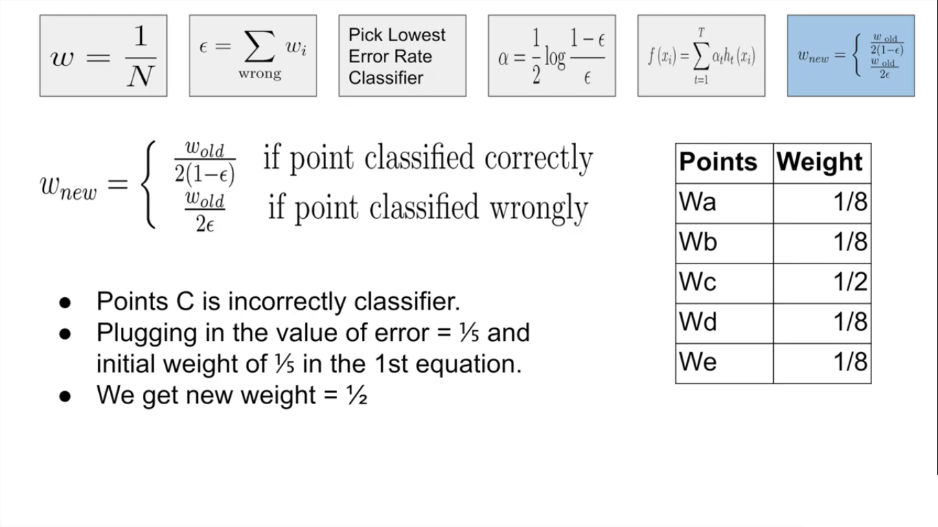
Ada Boost Example

Slide 31
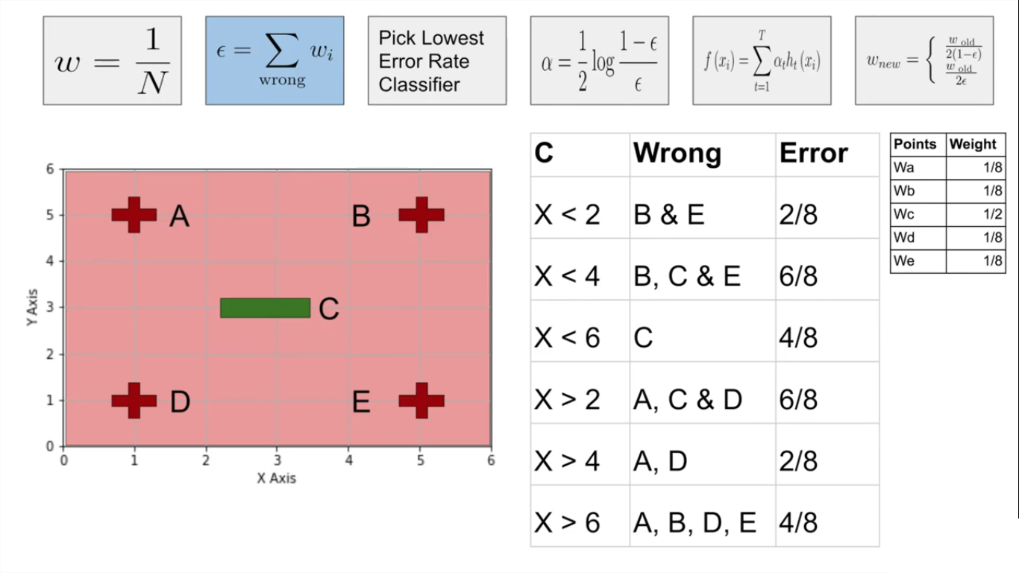
Round 2 with new values of W

Slide 32
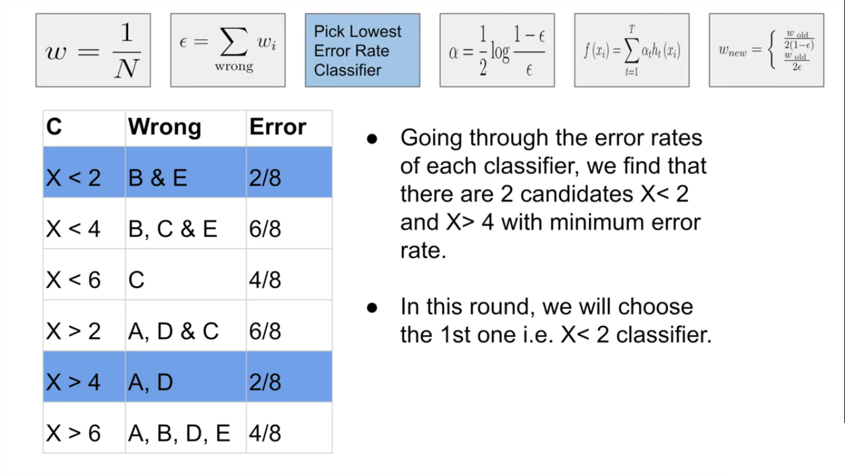
Round 2 with new values of W

Slide 33
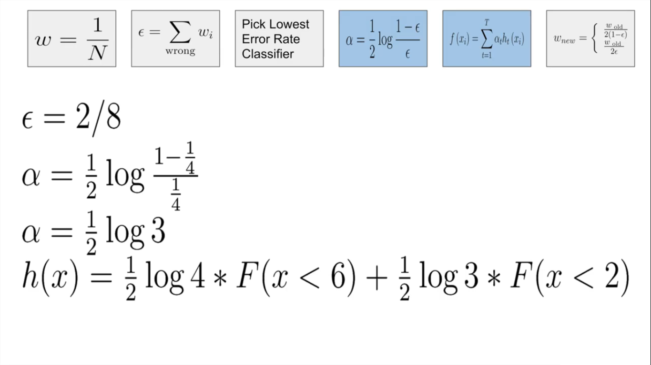
Round 2 with new values of W

Slide 34
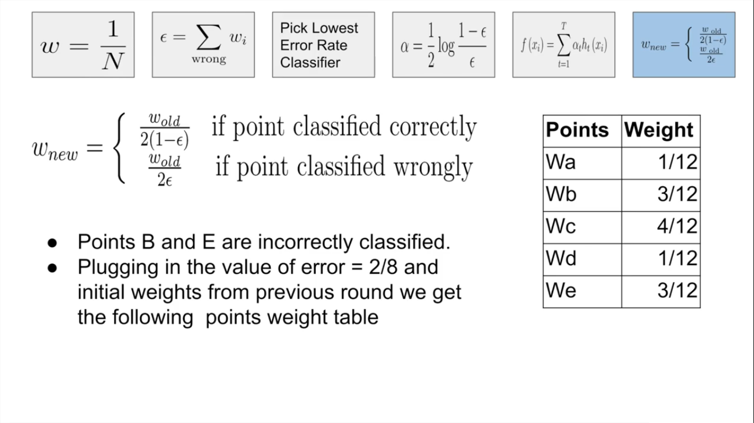
Round 2 with new values of W

Slide 35
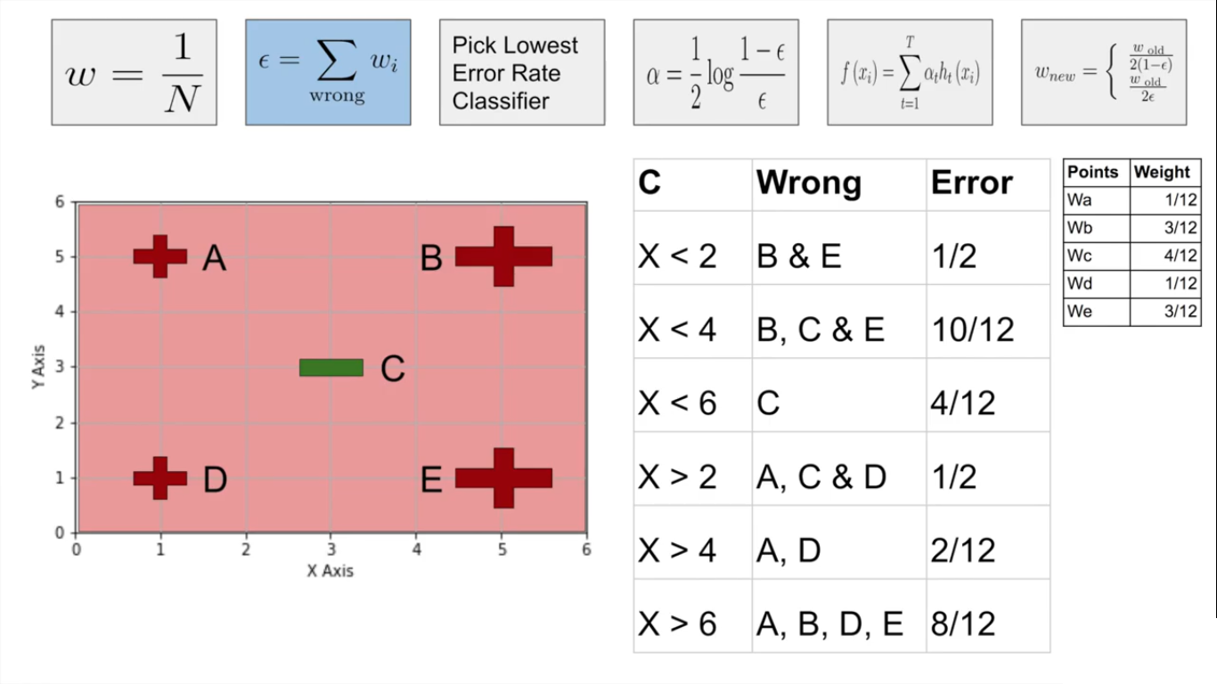
Round 3 with new values of W

Slide 36
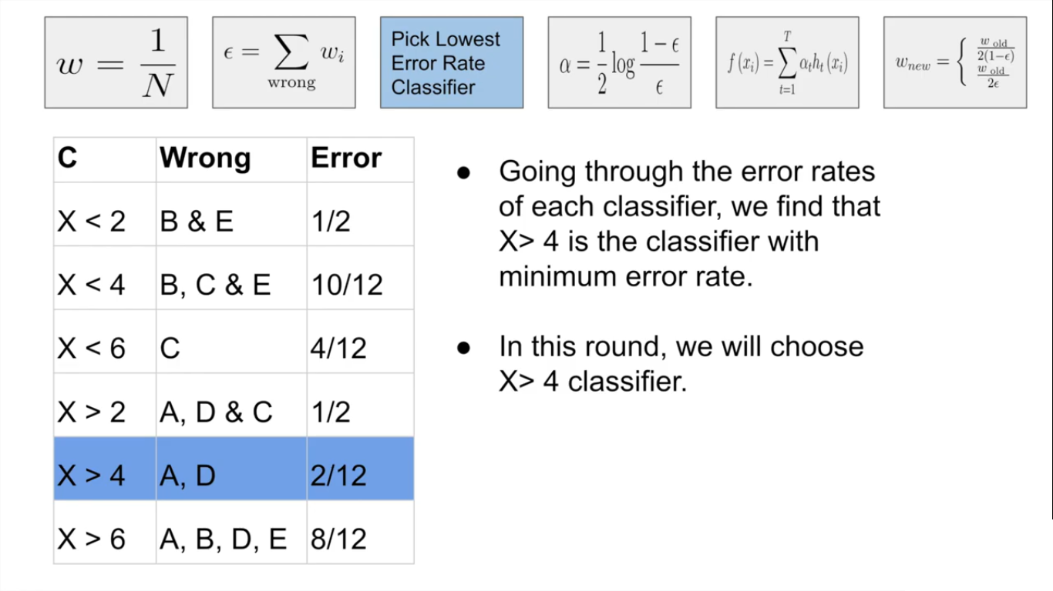
Round 3 with new values of W

Slide 37
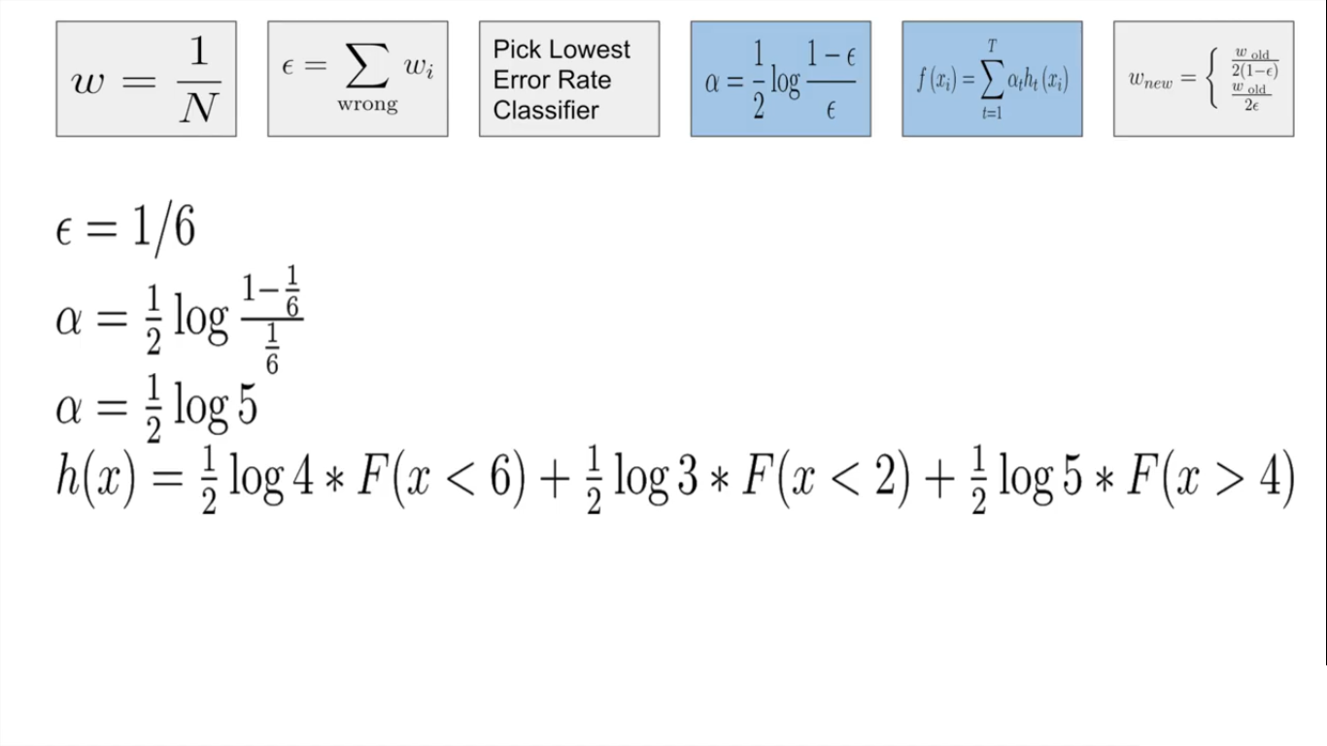
Round 3 with new values of W
Miss class C
Miss class B and E
Miss class A and D
Any two added together is greater than third.

Slide 38
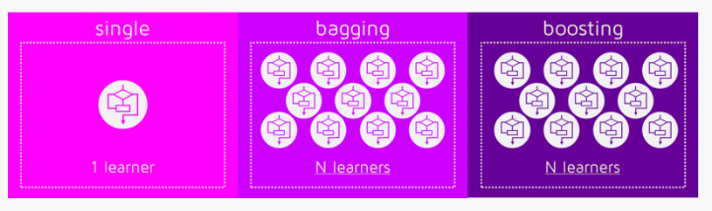
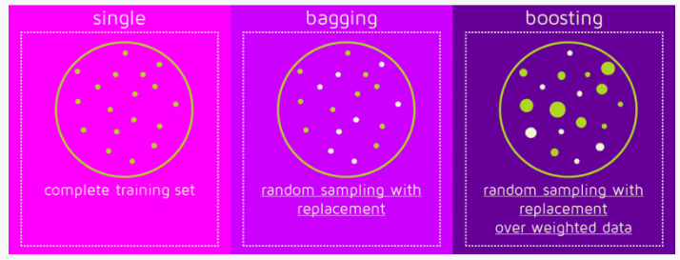
BAGGING VS BOOSTING

Slide 39
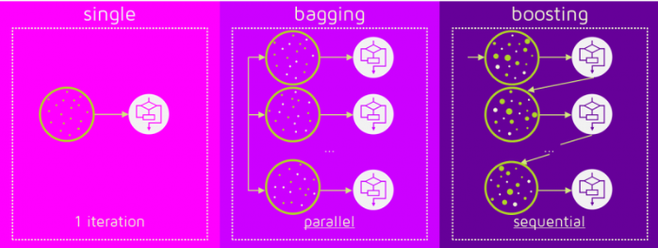
BAGGING VS BOOSTING

Slide 40
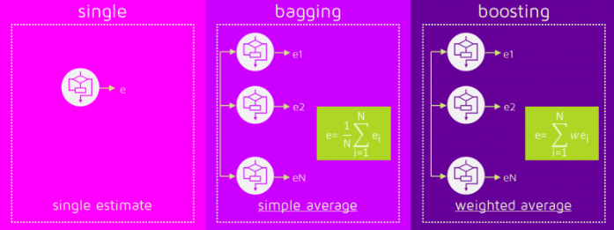
BAGGING VS BOOSTING

Slide 41
Sources
https://www.inf.uszeged.hu/~tothl/ML
Chapter 13, Marsland Stephen, Machine Learning – An Algorithmic Perspective, 2e, CRC Press,2015.
Chapter 17, Alpaydin Ethem. Introduction to Machine Learning, 3e, PHI, 2014.
https://www.youtube.com/watch?v=9CPsYsB4OLI

Slide 42
Thank You!

